Slide 1
Phys 129L
Stimulating Molecular Spectroscopy

Slide 2
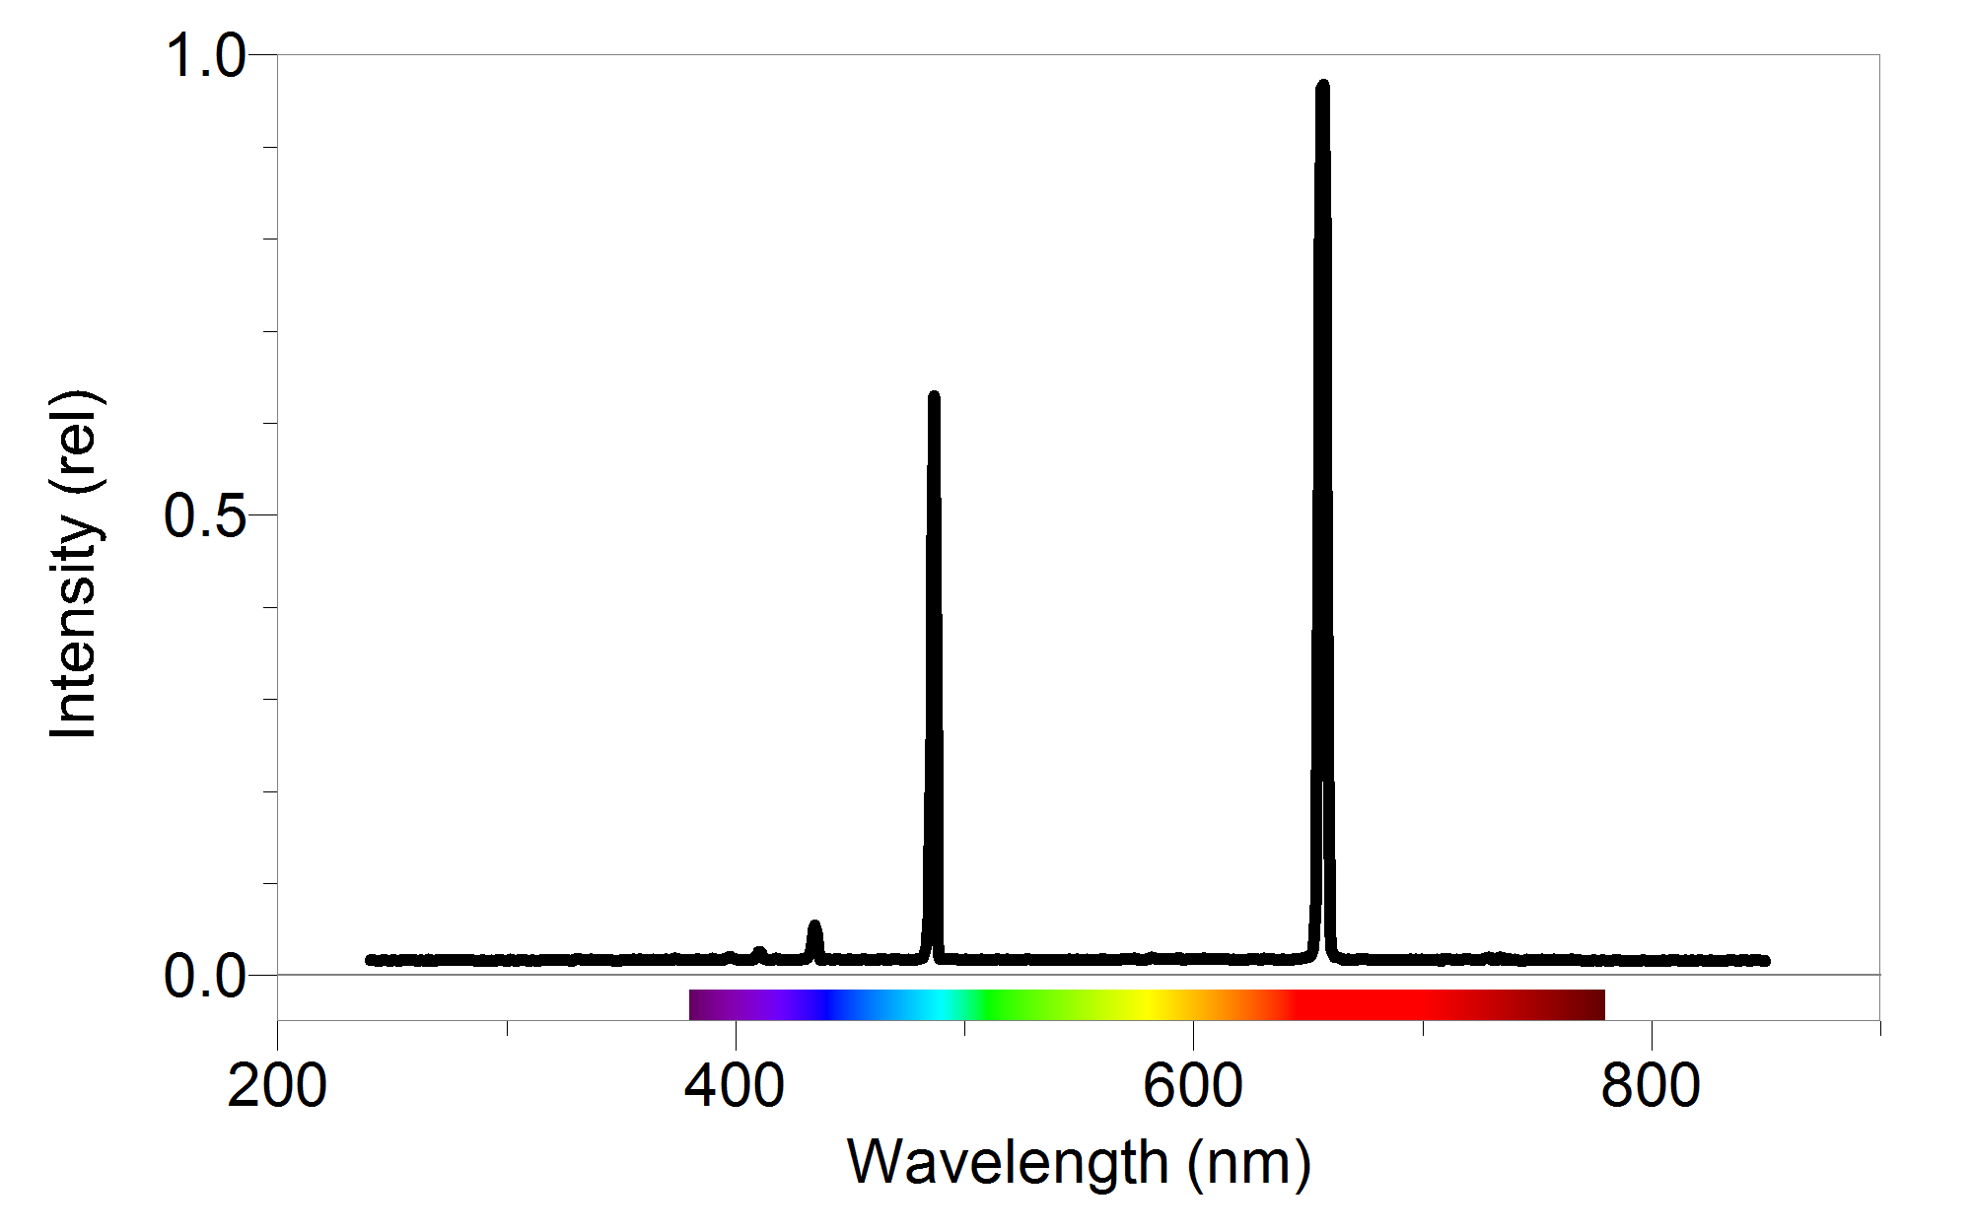
Molecular Spectroscopy
Transitions for atoms are easy
Transitions for molecules are HARD!

Slide 3
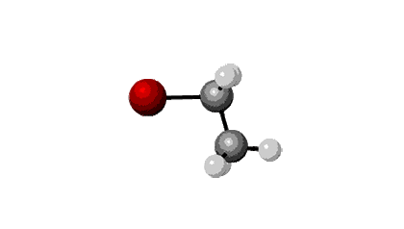
Why do we care?
Can be a ‘molecular fingerprint’
Can analyze reactions slowly
For fun science
Has to be rotational spectrum-isomers

Slide 4
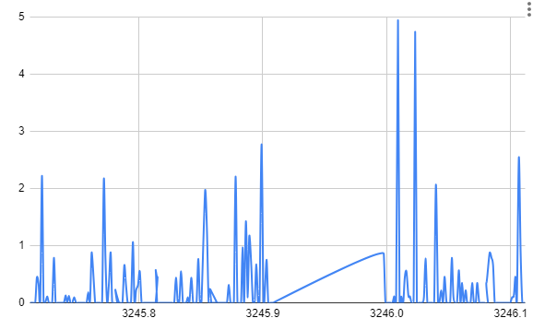
Patterson Lab:
Traps ions in a ion trap
Shoots with Mid-IR laser
Why so many peaks?

Slide 5
Rotational Spectroscopy!!
For a linear molecule, I_x=I_y, so there are two degrees of freedom, z, and x-y.
Transitions j->j+1, j->j-1 or j->j
Also vibrational transitions

Slide 6
Plan:
Each transition is an element of the Hamiltonian
Just find the eigenvalues of the hamiltonian!
Will be a sparse matrix
Use sparse matrix solver (sp.sparse.solve)

Slide 7
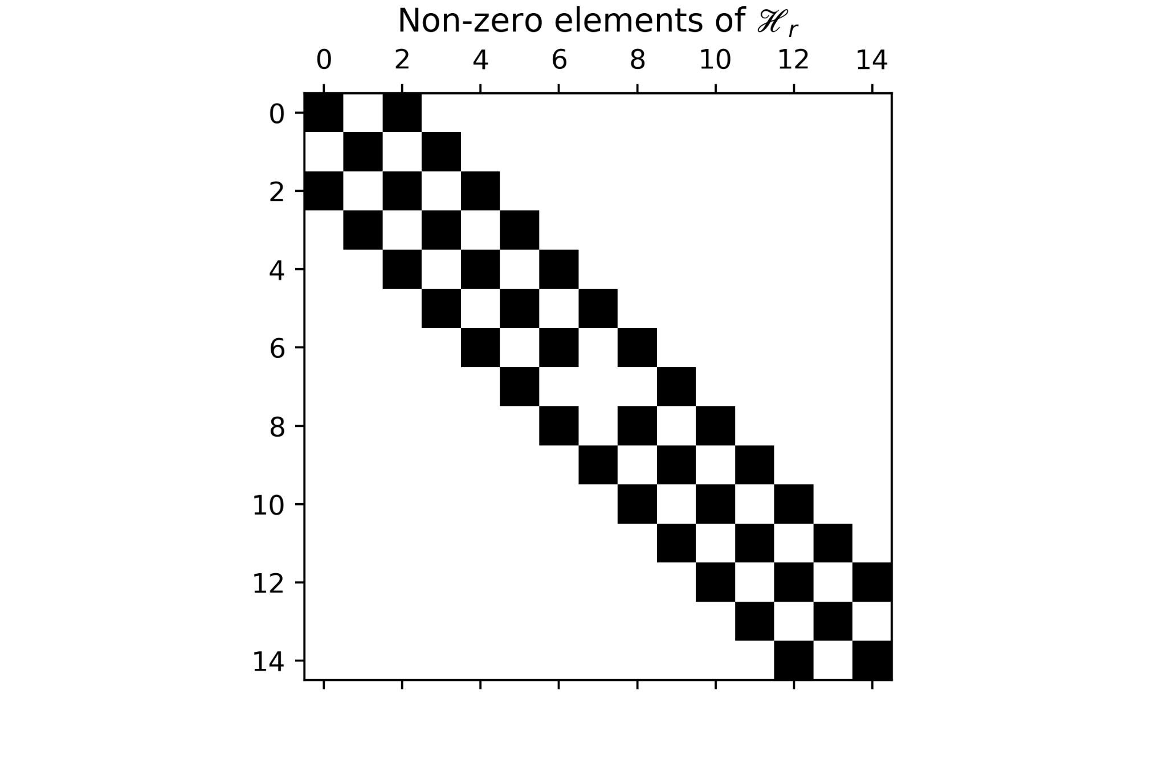
Results:
Each transition is a matrix element, but many transitions are forbidden so results in a sparse matrix.
Use sparse matrix solver.

Slide 8
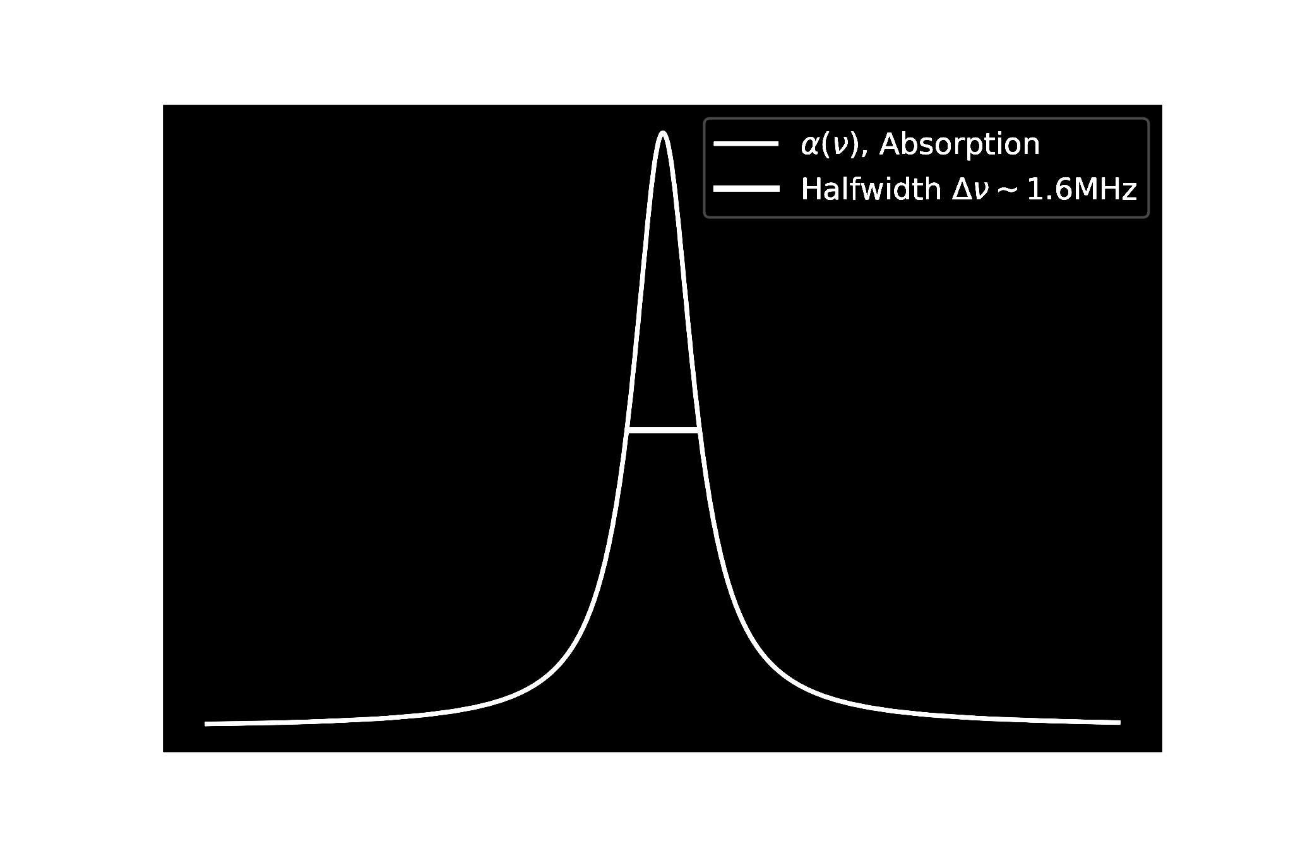
Results (cont.)
More cool graphs and actually details.
1.6Mhz~0.0000534cm^-1

Slide 9
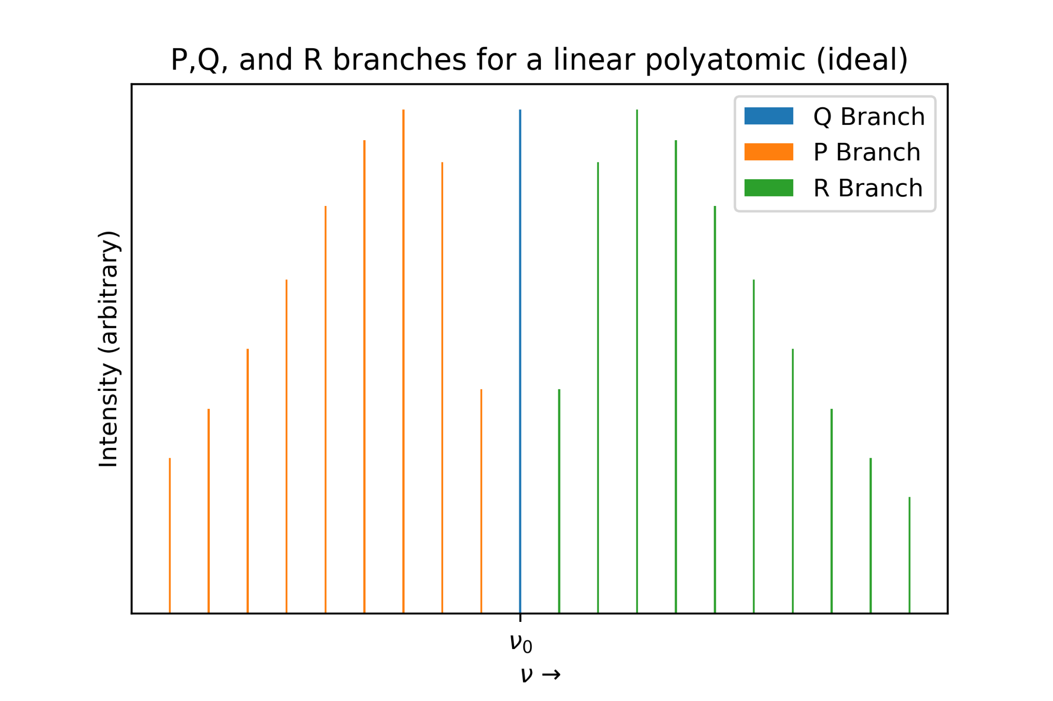
Results: (cont.)

Slide 10
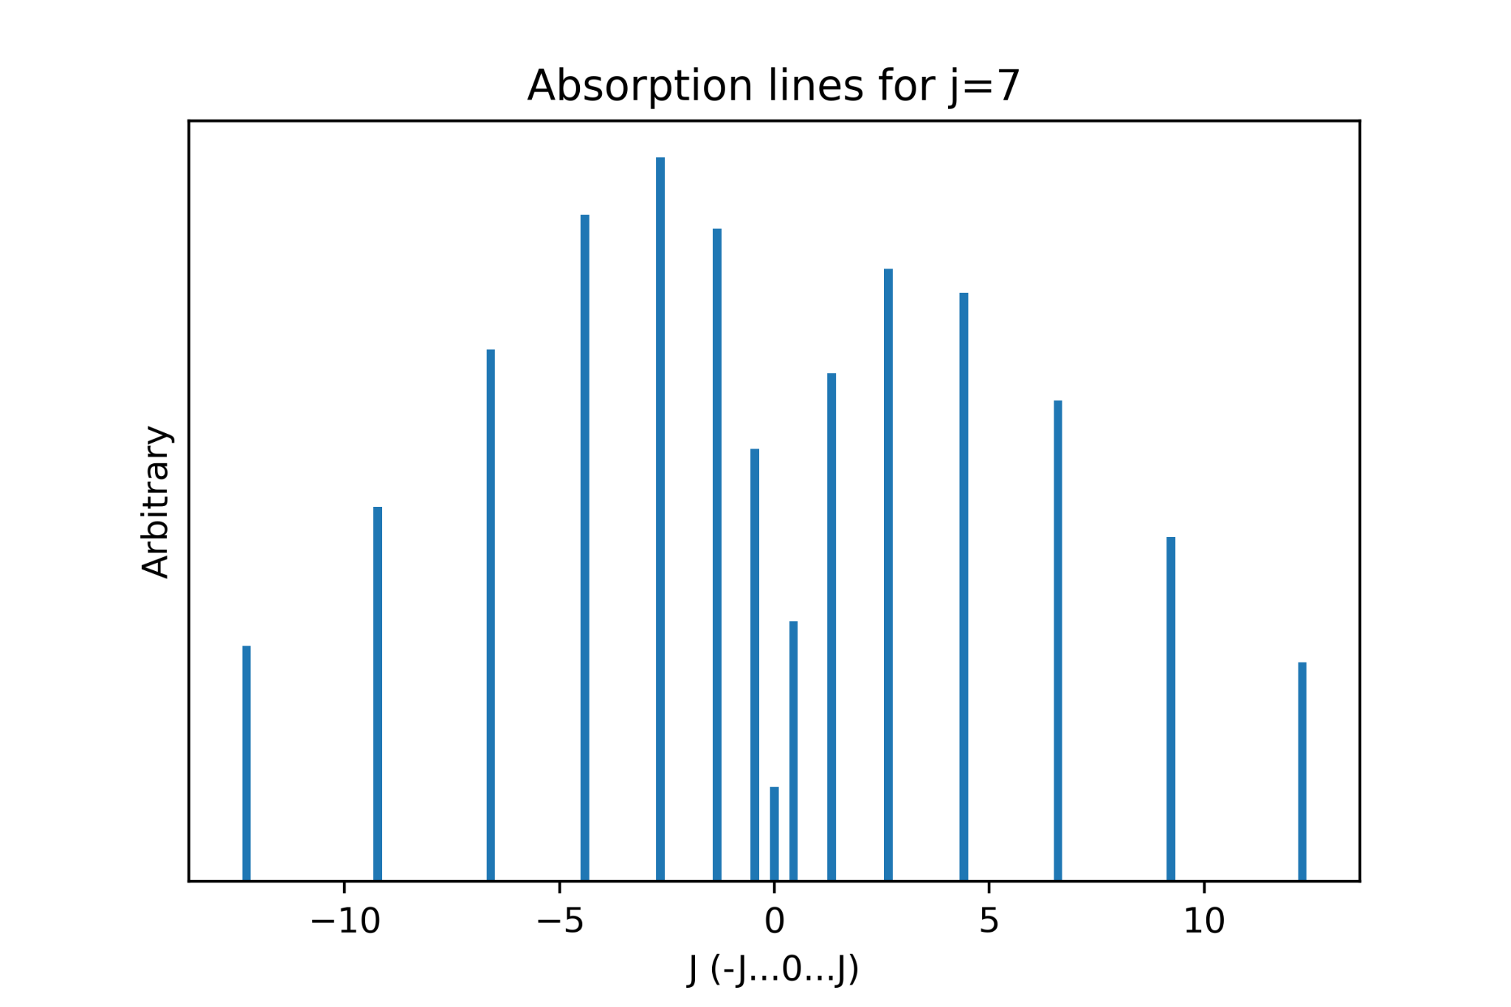
Results: (cont.)

Slide 11
Reflections:
Did not include ro-vibrational coupling or centrifugal distortion (big deal)
Physics was extremely complicated and math was boring.

Slide 12
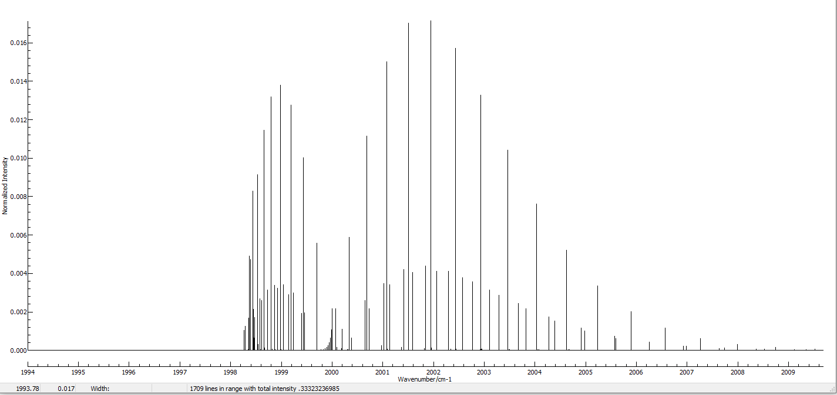
PGopher
This is a current program!
“The pgopher program is a general purpose program for simulating and fitting molecular spectra, particularly the rotational structure.” -PGopher white paper

Slide 13
References:
Robert L. Gordy, Walter; Cook. Microwave Molecular Spectra. Knovel, 3rd edition edition, 1984.
Aaron Calvin, Scott Eierman, Zeyun Peng, Merrell Brzeczek, Samuel Kresch, Elijah Lane, Lincoln Satterthwaite, and David Patterson. Non- destructive inelastic recoil spectroscopy of a single molecular ion: a versatile tool toward precision action spectroscopy, 2023.
Colin M. Western, PGOPHER: A program for simulating rotational, vibrational and electronic spectra, Journal of Quantitative Spectroscopy and Radiative Transfer, Volume 186, 2017,

